Slide 1
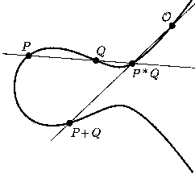
Inroduction
Elliptic Curve Cryptography

Slide 2
ECC was introduced by Victor Miller and Neal Koblitz in 1985
ECC provides same level of security with smaller key sizes.
A 256 bit ECC public key provides comparable security to a 3072 bit RSA public key. The primary advantage of using ECC based cryptography is reduced key size hence speed.
Elliptic curves have nothing to do with ellipses. Ellipses are formed by quadratic curves.(x² ).Elliptic curves are always cubic (x³ )
Block chain implementations such as Bitcoin or Ethereum uses the Elliptic curves to generate public and private keys

Slide 3
parameters | Elliptic curve key length | RSA key length
secp192kl | 192 | 1536
secp224kl | 224 | 2048
secp256kl | 256 | 3072
secp384kl | 384 | 7680
secp512kl | 512 | 15360
Bitcoin and ethereum both uses same secp256kl elliptic curve domain parameters

Slide 4
Standards for efficient cryptography group
The Standards for Efficient Cryptography Group (SECG) is an international consortium to develop commercial standards for efficient and interoperable cryptography based on elliptic curve cryptography
The SECG has published a document with a recommended set of Elliptic curve domain parameters referred by the letters p,a,b,G,n,h. This data set { p,a,b,G,n,h} collectively referred to as Elliptic curve domain parameters.
These parameters have been given nick names to enable them to be easily identified. For example secp256 kl set of elliptic curve parameters 256 key key length

Slide 5
An elliptic curve is the set of solutions (x, y) to an equation of the form
y² = x³ + ax + b
If 4a³ + 27b² ≠ 0-------Nonsingular elliptic curve
Singular elliptic curve

Slide 6
ECC parameters::
P--Prime specifying the field GF(p). Galois field(p)
a,b--The two coefficients of the Weierstrass equation y^2 = x^3 + ax + b
G- - Base point g.
n--Order of g
Q--The point representing the public key Q = dG.
d--The private key d
h– hash function

Slide 7
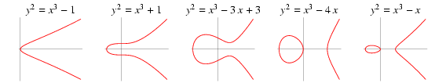
Examples

Slide 8
GF(p) :
It is a finite field and it consists of a set of integers {0,1,2,3….p-1} where p is a prime number. Additionally it satisfies the following arithmetic operations
The line connecting the two points does not intercept the curve at a third point
But, mathematicians say that the intercepting point is at infinity. They define a point O as the point at infinity or zero point,which is additive identity of the group

Slide 9
Elliptic Curve over GF(p)
P and Q be two points on E_{(a,b)}(GF(p)) and O is the point at infinity.
P+O = O+P = P
If P = (x₁,y₁) then -P = (x₁ ,-y₁)
and P + (-P) = O.
If P = (x₁,y₁) and Q = (x₂,y₂), and P and Q are not O.
then P +Q = (x₃ ,y₃) where
x₃ = λ² - x₁ - x₂
y₃ = λ(x₁ - x₃) - y₁
and λ = (y₂-y₁)/(x₂-x₁) if P ≠ Q
λ = (3x₁²+a)/ 2y₁ if P = Q

Slide 10
Finding an inverse
The inverse of a point (x,y) is (x,-y) where –y is the additive inverse of y.
For example ,if p=13,the inverse of (4,2) is (4,11)

Slide 11
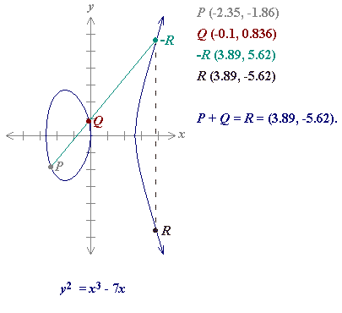
If P≠ Q

Slide 12
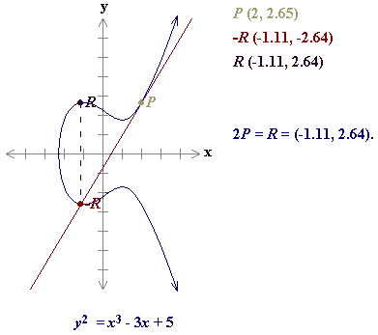
If P=Q i.e R=P+P=2P
P+P = 2P

Slide 13
Finding the points over the curve
elliptiCurve_points(P,a,b) //p is the modulus
{
x=0
while(x<P)
{
w ← (x³ + ax +b) mod p // w is y²
if (w is perfect square in Z_{P}) output (x,√w)(x,- √w)
x=x+1
}
}

Slide 14
Define an elliptic curve E₁₃(1,1).points on the curve can be found as shown
(0,1) | (0,12)
(1,4) | (1,9)
(4,2) | (4,11)
(5,1) | (5,12)
(7,0) | (7,0)
(8,1) | (8,12)
(10,6) | (10,7)
(11,2) | (11,11)

Slide 15
Adding Two points:
Let us add two points in the prevoius example,R=P+Q where P=(4,2) and Q= (10,6)
a. λ=(6-2) × (10-4)⁻¹ mod 13=4 × 6⁻¹ mod 13=5 mod 13
b. x=11
c. y=2
R=(11,2) which is a point on the curve

Slide 16
Multiplying a point by a constant:(Scalar Multiplication)
Scalar multiplication is repeated group addition:
cP = P + ··· + P (c times)
where c is an integer

Slide 17
Generic Procedures of ECC
Both parties agree to some publicly-known data items
The elliptic curve equation
values of a and b
prime, p
The elliptic group computed from the elliptic curve equation
A base point, B, taken from the elliptic group
Similar to the generator used in current cryptosystems
Each user generates their public/private key pair
Private Key = an integer, x, selected from the interval [1, p-1]
Public Key = product, Q, of private key and base point
(Q = x*B)

Slide 18
Elliptic Curve Cryptosystem Analog to El Gamal
Suppose Alice wants to send to Bob an encrypted message.
Generating Public and Private keys.
Bob chooses E(a,b) with an elliptic curve over GF(p)
Bob chooses a point on the curve,e₁(x₁, y₁)
Bob chooses an integer d.
Bob calculates e₂(x2,y2)=d × e1(x1,y1)
public key={E(a,b),e1(x1,y1),e2(x2,y2)}
privte key=d
Alice takes plaintext message, M, and encodes it onto a point, P from the elliptic group

Slide 19
Elliptic Curve Cryptosystem Analog to El Gamal
To Encrypt
Alice chooses another random integer, k from the interval [1, p-1]
The ciphertext is a pair of points
C1=r×e1 C2= P+r×e2
To decrypt,
Bob computes plaintext with his private key, d
P=C2 – (d × C1)
The minus sign here means adding with the inverse

Slide 20
Example
Bob selects E₆₇(2,3) as elliptic curve over GF(P)
Bob selects e1=(2,22) and d=4.
Bob calculates e2=(13,45), where e2=d × e1.
Bob publicly announces the tuple( E,e1,e2)
Alice wants to send the plaintext P=(24,26) to Bob. Alice selects r=2.
Alice finds the point C1=(35,1),where C1 = r × e1.
Alice finds the point C2=(21,44),where c2=P + r × e2.
Bob receives C1 and C2.He uses 2 × C1(35,1) to get (23,25)
Bob inverts the point (23,25) to get the point (23,42)
Bob adds (23,42) with C2=(21,44) to get the original plaintext P=(24,26).

Slide 21
Analogy with Multiplicative Groups

Slide 22
Security of ECC
The security of ECC depends on the difficulty of solving the elliptic curve logarithm problem.

